Slide 1
HTML Review
Week 2 Session1

Slide 2
Contents of This session
Review of HTML language

Slide 3
What is HTML
HTML = Hyper Text Markup Language
Describes the content & structure of information on web page
Not the appearance on screen
Composed of several HTML elements
Each element contain open/start and close/end tags
Syntax:
<element name [attributes]>[content]</element name>
Example: <p style=“color:blue;”>Hello</p>

Slide 4
Creating HTML Documents
Edit document by hand
Use text editor to edit the text and markup
Save as a ".html" file
Open the file in a web browser
Authoring tools
Could drag & drops HTML elements
Adobe Dreamweaver, Microsoft Front Page, Microsoft Expression Web, etc.

Slide 5
HTML Structure
<!DOCTYPE html> <html>
<head>
<meta charset = “utf – 8”> <title>Page Title</title> </head> <body> Page contents go here </body> </html>
Document type declaration
Html element contains entire document
Head element contains descriptive information about the document
Meta element used to provide all sort of information
Title element provides a title of a document
Body element contains all contents to show in our browsers

Slide 6
Marking Up Text -- Headings
Use h elements to indicate headings for a webpage
There are six levels of headings
Best practise to start with Level 1 heading(h1)
<h1>...</h1>
<h2>...</h2>
<h3>...</h3>
<h4>...</h4>
<h5>...</h5>
<h6>...</h6>
Heading elements

Slide 7
Marking Up Text -- Paragraphs
indicate a paragraph with the p element
<p>...</p>
A paragraph element
Example:
<p>Serif typefaces have small slabs at the ends of letter strokes. In
general, serif fonts can make large amounts of text easier to read.</p>

Slide 8
Marking Up Text -- Lists
HTML provides elements for marking up three types of lists:
Unordered lists. Collections of items that appear in no particular order.
Ordered lists. Lists in which the sequence of the items is important.
Description lists. Lists that consist of terms and definitions.

Slide 9
Marking Up Text -- Lists
Syntaxes of List elements:
<ul>
<li>....</li>
<li>....</li>
<li>....</li>
<li>....</li>
</ul>
Unordered list
<ol>
<li>....</li>
<li>....</li>
<li>....</li>
<li>....</li>
</ol>
Ordered list
<dl>
<dt>....</dt>
<dd>....</dd>
<dt>....</dt>
<dd>....</dd>
</dl>
Description list
http://www.w3schools.com/html/html_lists.asp

Slide 10
Adding Images
Use img element to add an image to a document
img element is an empty element(no content & no end tag)
Syntax:
<img src="bird.jpg" alt="photo of bird">
Location of an image
alternate text for an image

Slide 11
Adding links
Use a element to create a hyperlink to other sites
Syntax:
<a href=“http://www.google.com”>go to google</a>
Use an image as a link
<a href=“http://www.google.com”><img src=“google.gif” alt = “google logo”></a>
the URL of the target page

Slide 12
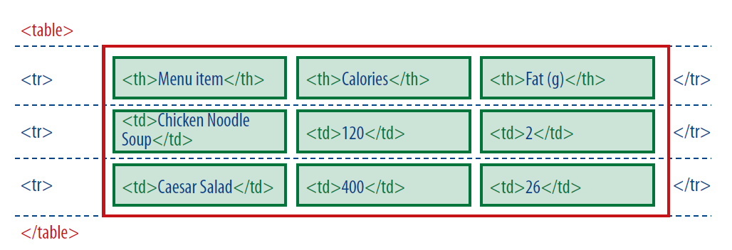
Creating a Table
HTML table element and its child elements
<table>...</table>
Defines a table
<tr>...</tr>
Table row
<th>...</th>
Table header
<td>...</td>
Table cell data

Slide 13
HTML Form
HTML Forms are used to collect user input
HTML forms contain different types of input elements
Syntax:
<form action = “…” method =“get/post”>
..form elements..
</form>
A HTML Form

Slide 14
HTML Form Elements
Form elements are defined using <Input> Element
Syntax:
<Input type =“…” name = “…” [value =“…”] >
A Form Input
The <input> element has many variations, depending on the type attribute.
name attribute defines name of an input element
value attribute specifies the value of an <input> element.
The value attribute is used differently for different input types

Slide 15
HTML Form Elements
List of Input types for a form
Checkbox
Radio Button
Submit button
Textbox
and more on w3schools
Textarea
Drop-Down List

Slide 16
Exercise
Webpage Creation Exercise
Table Exercise
Image Gallery Exercise

Slide 17
End of The Session 1
Week 2

